Slide 1
ages 5-7
Crazy Characters
Understanding algorithms

Slide 2
Today we are learning about…
Algorithms
I can say what an algorithm is
I can write an algorithm
I can use an algorithm
I can improve my algorithm

Slide 3
Now listen very carefully and follow my algorithm
Is yours the same as your partner’s?
Let’s look at my algorithm

Slide 4
How to draw a fluffy algorithm…
Draw a circle for the body
Add 2 eyes
What is an algorithm?
Add a crown
Add wings
Add four legs

Slide 5
An algorithm is a list of instructions, or rules, that make something happen or work something out
Alligator algorithm, step, step, step,
She’s very, very bossy,
But she gets things done.
How to draw a character,
How to play a game,
Alligator algorithm 1,2,3!

Slide 6
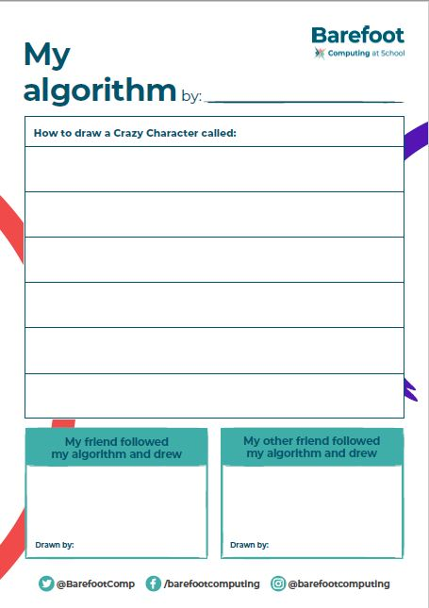
Let’s make a class Crazy Character…

Slide 7
Now it’s your turn:
Think of a character
Write each step of your algorithm
When you have done all your steps get a friend to try it
Was it what you expected?
Change your algorithm to improve it
Get another friend to try it
What did you find out?

Slide 8
Example:

Slide 9
Example:

Slide 10
Example:

Slide 11
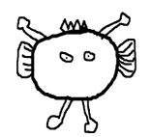
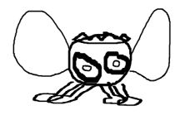
Example:

